Slide 1
CSCI 222-System Development Assignment 1
Team b9:
Clifton Chiang ZHI hoong
Loo ting xian
Khuan hu
Ang yi xiang
Chiew jun yong
Lin sen

Slide 2
Project overview
- Vision
The general vision of the warehouse management tool is to provide users with summary information of how the warehouse is performing so that the users can have a better understanding of day to day operation and therefore, be able to make critical management decisions.
- Key features of warehouse management system
Add, remove, edit and search for stocks
Track records of stocks according to category or sub category
Retrieve daily, weekly ,monthly or yearly summary reports of stock.
Provide login authentication with security feature for Administrator

Slide 3
Content
GANTT CHART
RISK ANALYSIS
COUNTER MEASURE
USE-CASE ITERATION
ACTIVITY WORK-FLOW
COMPONENT DIAGRAM
CLASS DIAGRAM
VCS

Slide 4
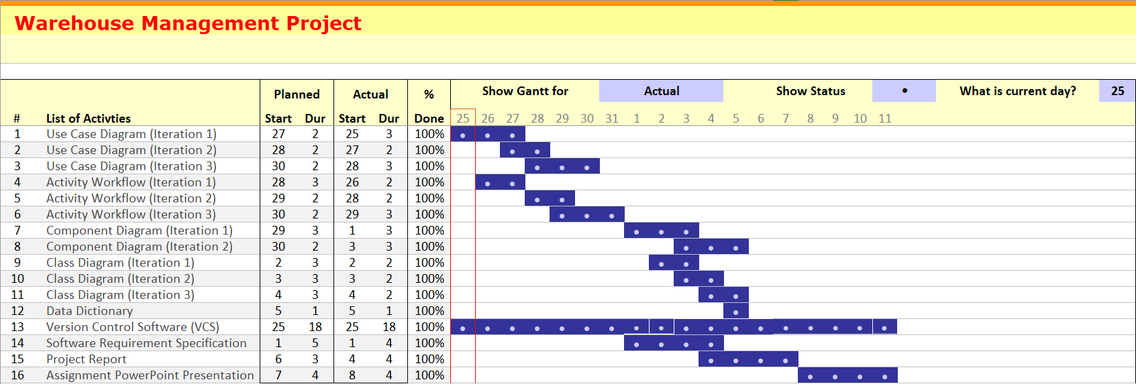
Gantt chart

Slide 5
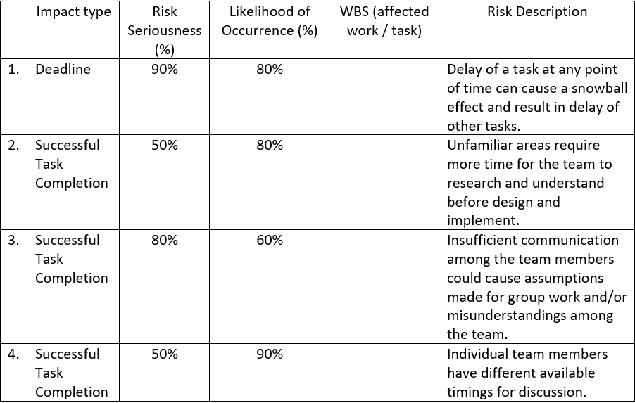
Risk analysis

Slide 6
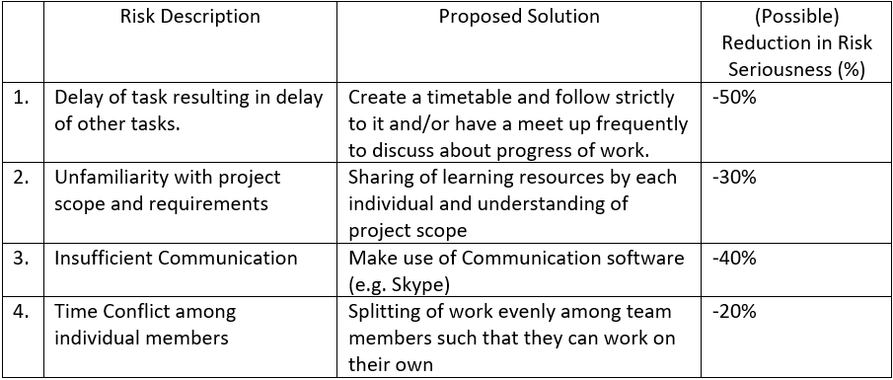
Counter measure

Slide 7
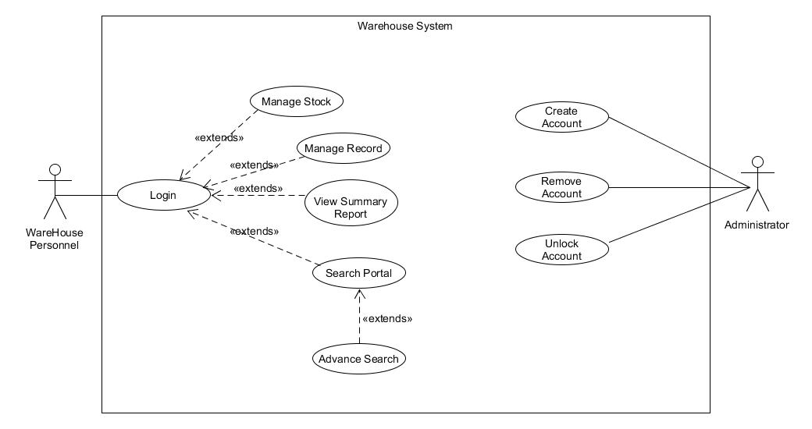
Use-case iteration 1

Slide 8
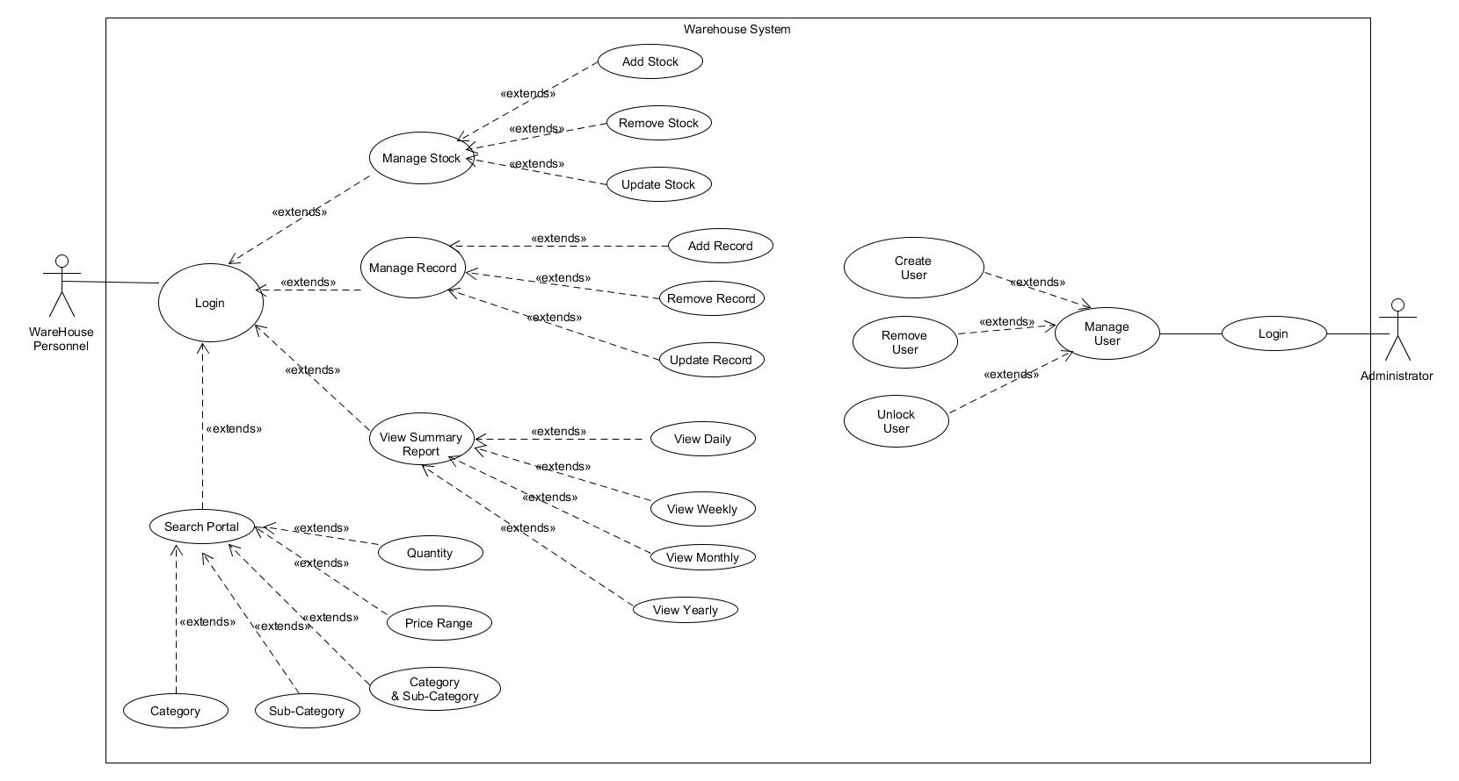
Use case iteration 2

Slide 9
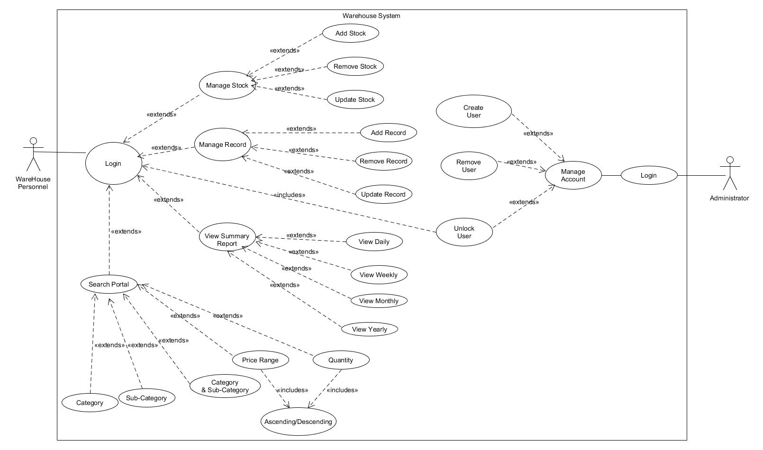
Use case iteration 3

Slide 10
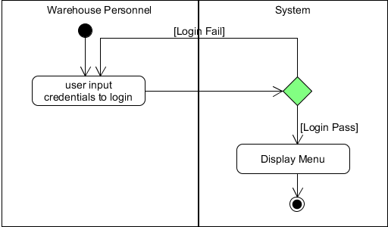
Login

Slide 11
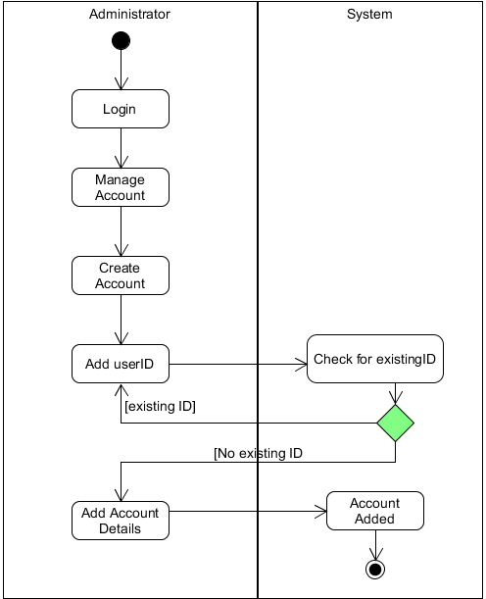
Create account

Slide 12
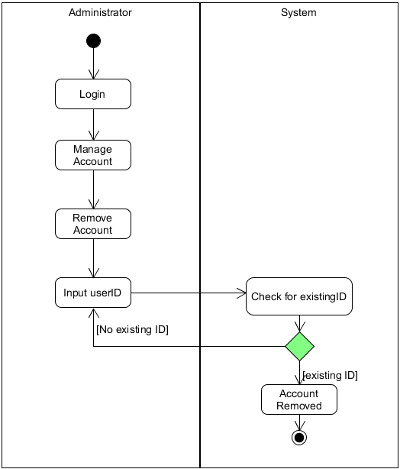
Remove account

Slide 13
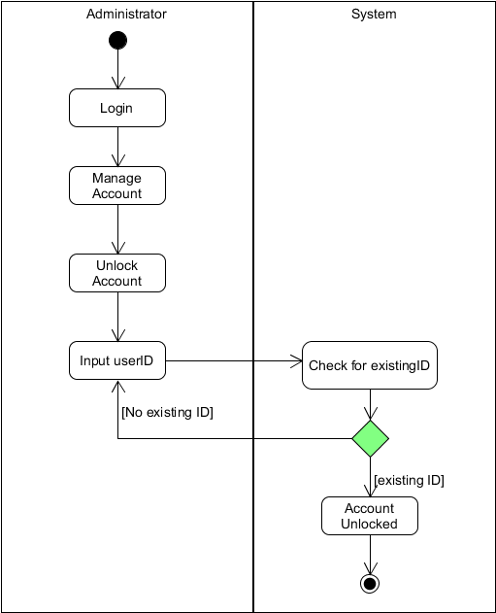
Unblock account

Slide 14
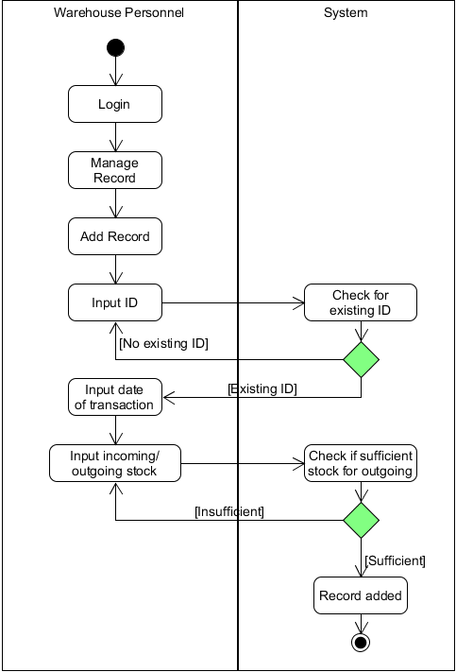
ADD RECORD

Slide 15
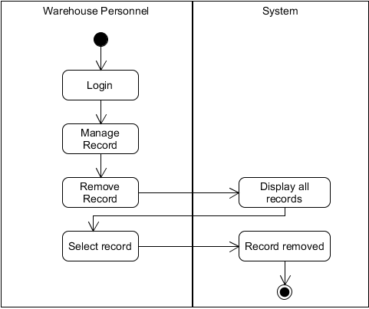
Remove record

Slide 16
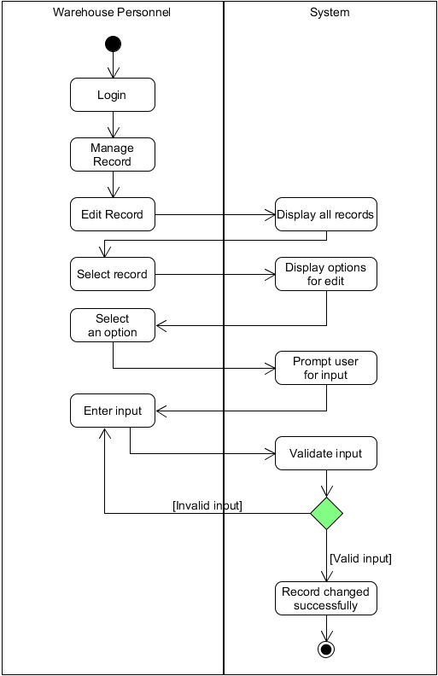
Edit record

Slide 17
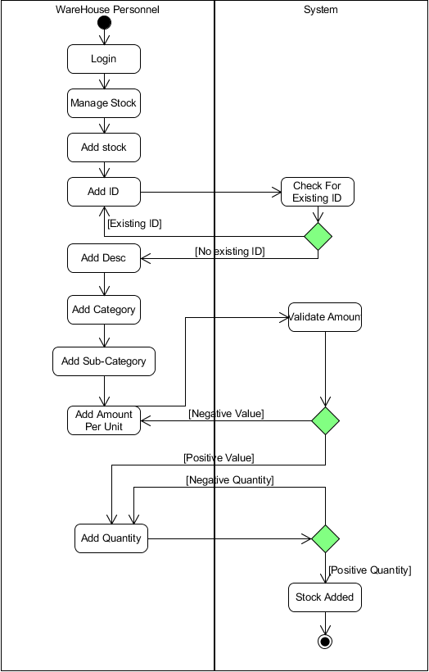
Add stock

Slide 18
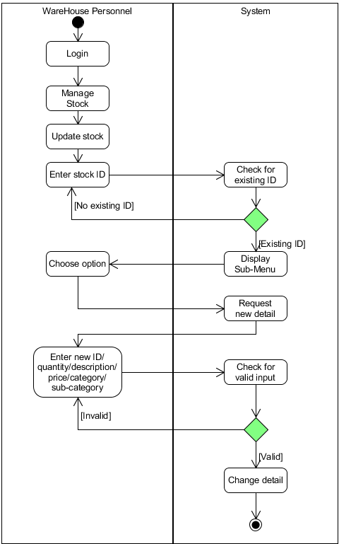
Update stock

Slide 19
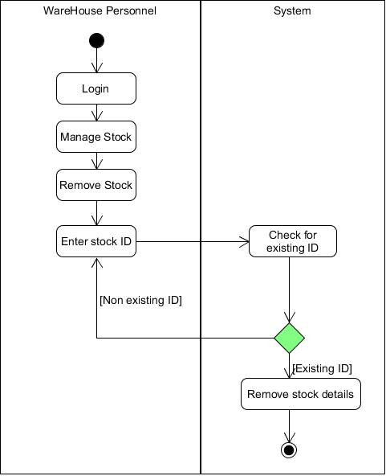
Remove stock

Slide 20
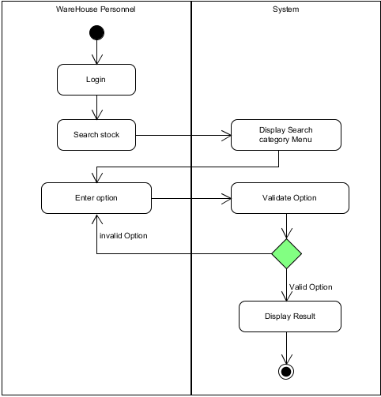
Search stock

Slide 21
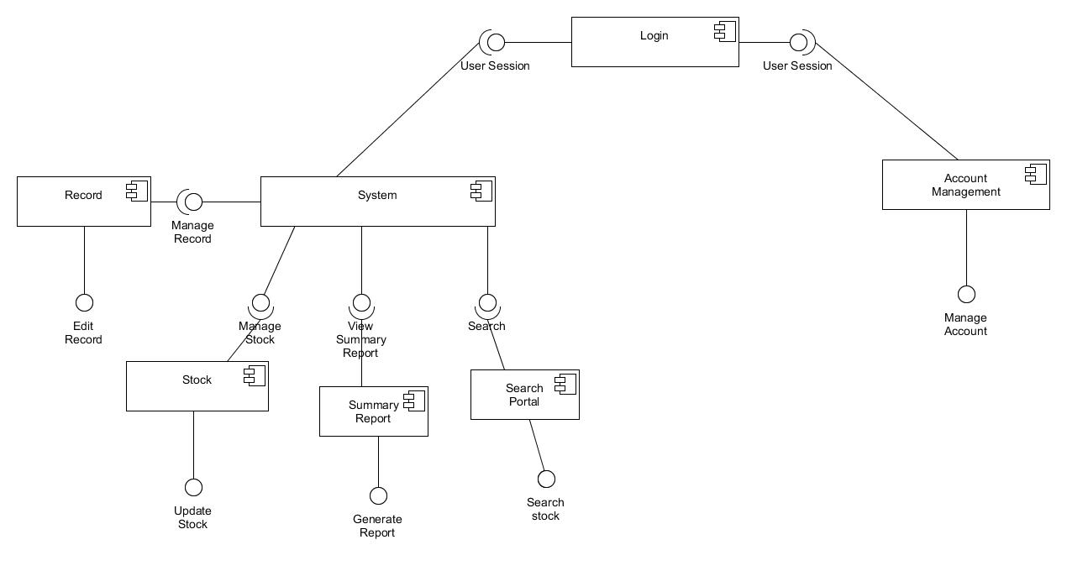
Component diagram iteration 1

Slide 22
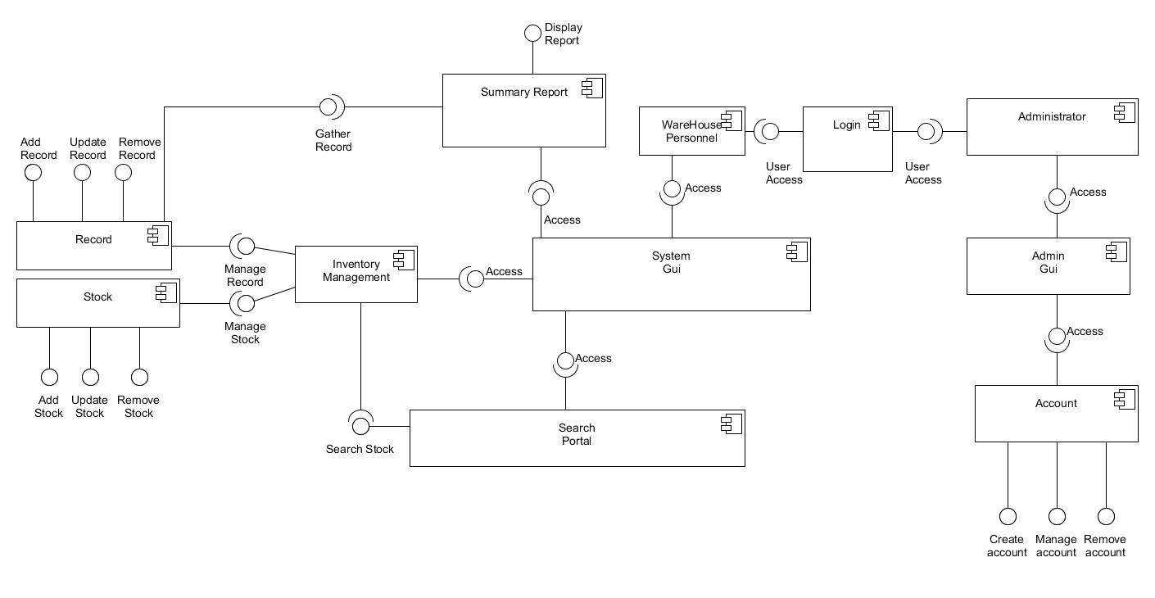
Component diagram iteration 2

Slide 23
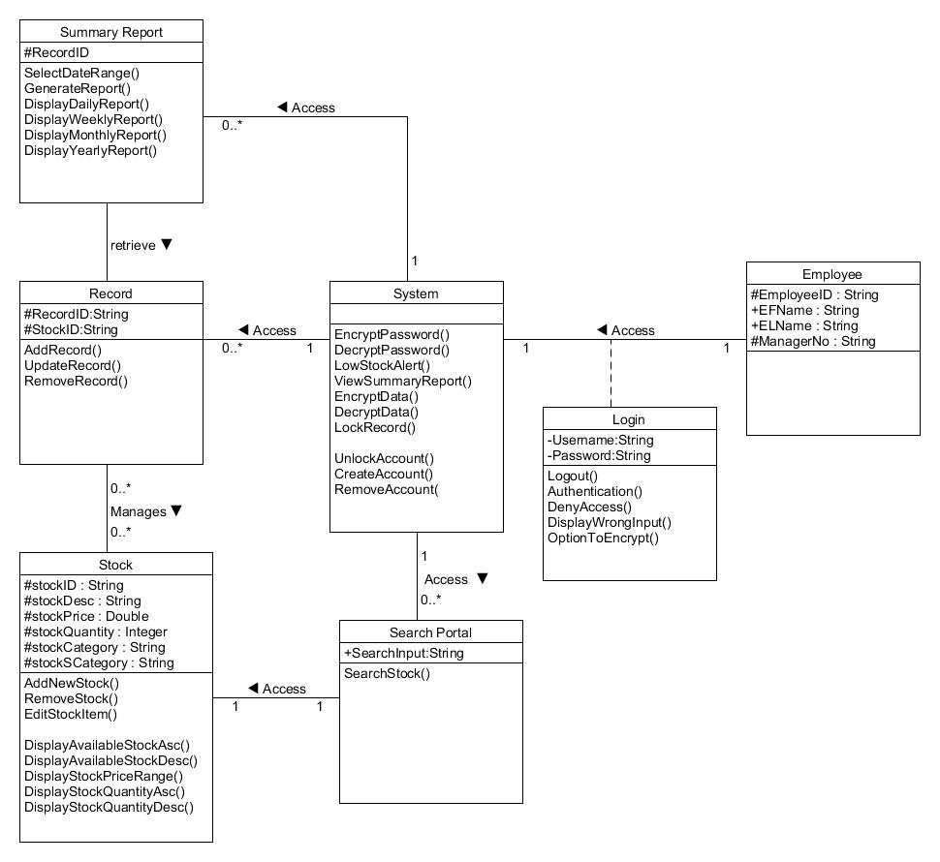
Class diagram iteration 1

Slide 24
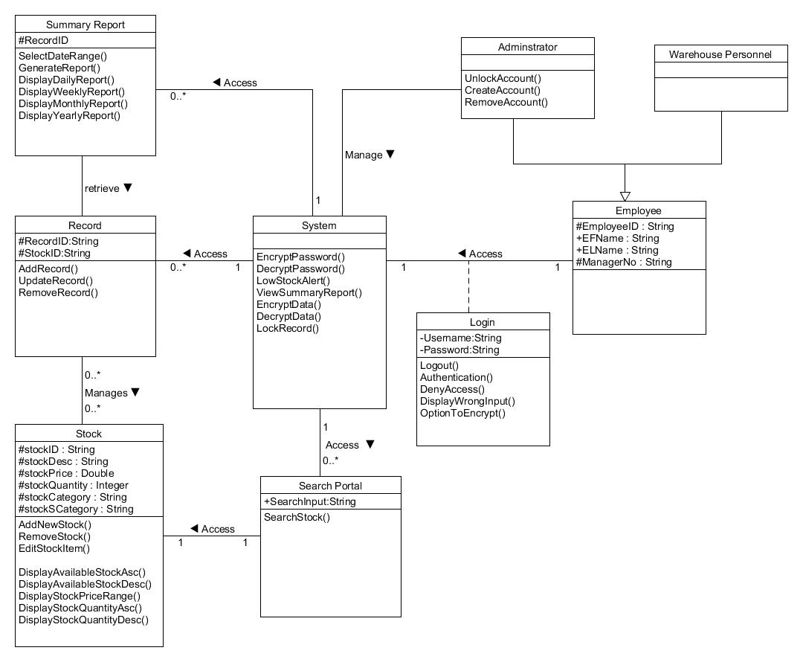
Class diagram iteration 2

Slide 25
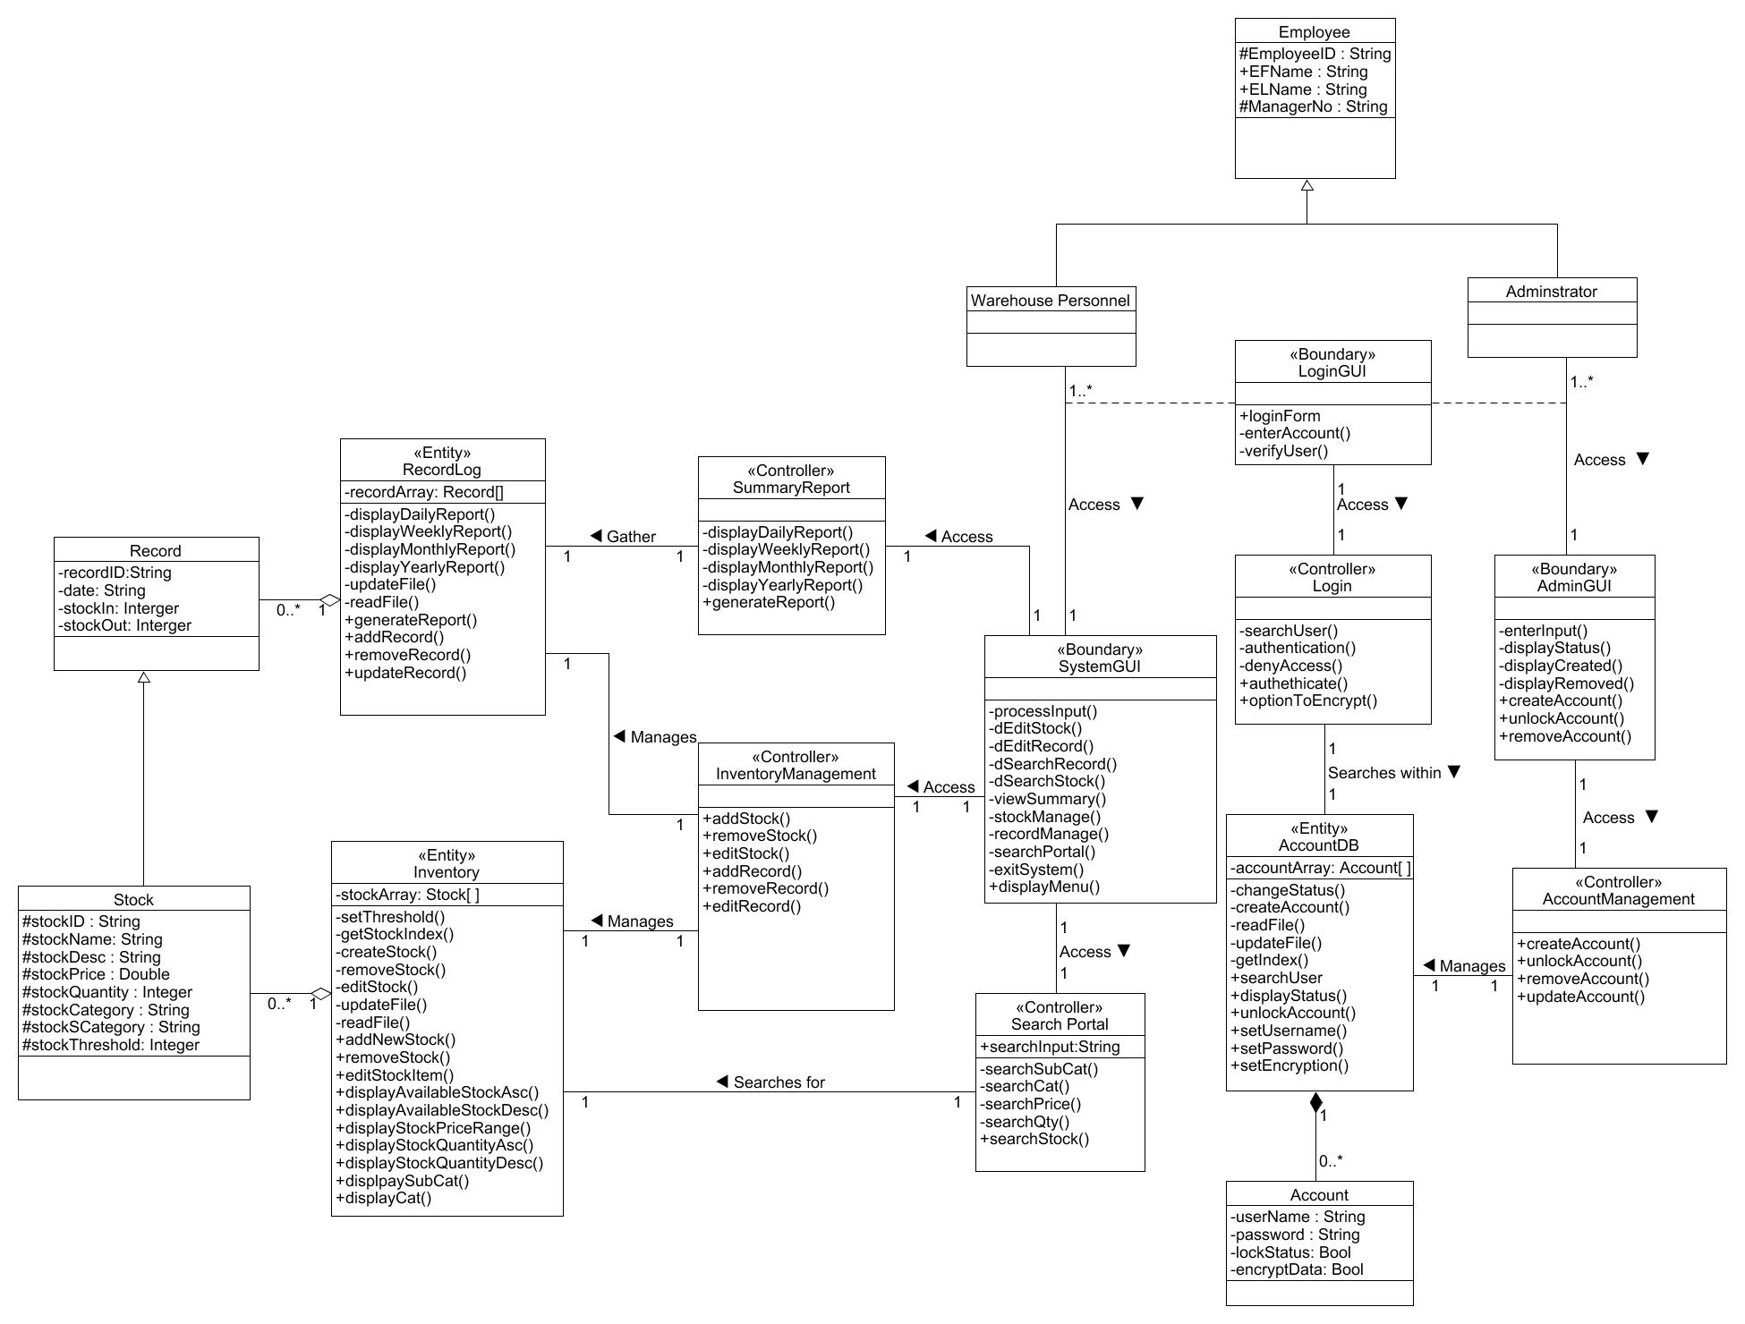
Class diagram iteration 3

Slide 26
Version control software

Slide 27
THANK YOU

